Slide 1


PROJECT PRESENTATION
Analysis of COVID-19 IMPACT on STATES in USA
Submitted By :
SHERIN JOSEPH
21 / May / 2021
Instructor : Hamid Rajaee

Slide 2
Introduction
This project gives us an insight about the impact of COVID-19 on 6 different states in USA for a period of 3 months. The data collected and following actions were performed :
Summarizations of the columns in dataset
Visualization of the variables
Univariate analysis
Bivariate Analysis

Slide 3
DATA SET
This following are the details of the data set:
Number of Columns : 6
Number of Rows : 581
Column Names : Date, State, Cases, Deaths, Recovered and Vulnerability
Name of states: Alabama, Arizona, California, Florida, Georgia and Texas
Time period : 3 months (October, November and December 2020)
Data Type : 1 Date, 2 Categorical and 3 numerical columns
Target Column : Vulnerability column
The vulnerability column has 3 categories “Critical” , “Low” and “Moderate” and our project focus on finding the relationships between target column and other predictor columns.

Slide 4
Case STUDY
The following are the case studies :
what is the distribution of target column (Vulnerability)
what is the distribution of States
what is the distribution of cases reported in all states
what is the pattern of recovery reported in all states
what is the total death in all states
what is the relation between states and Vulnerability Level
Is there relation between the month and Vulnerability Level
Is there relation between the Cases and Recovery
Is there relation between the Deaths and Recovery
Is there relation between the Cases and Vulnerability

Slide 5
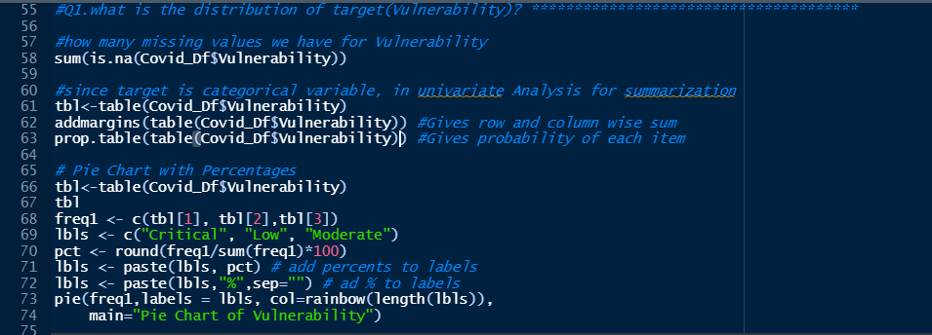
Univariate analysis
Q1. what is the distribution of target column (Vulnerability) [Categorical]

Slide 6
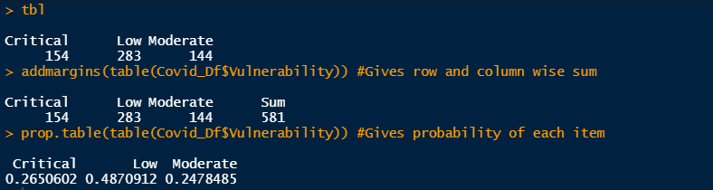
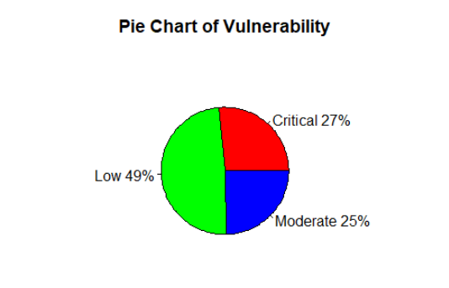
The table function returns the summarization of each category in the column.
Further details could be obtained by the add margins and prob.table function as shown beside.
The pie chart shows that 27% of the values in vulnerability column is “Critical”, 25% of “Moderate” and 49% of “low”.

Slide 7
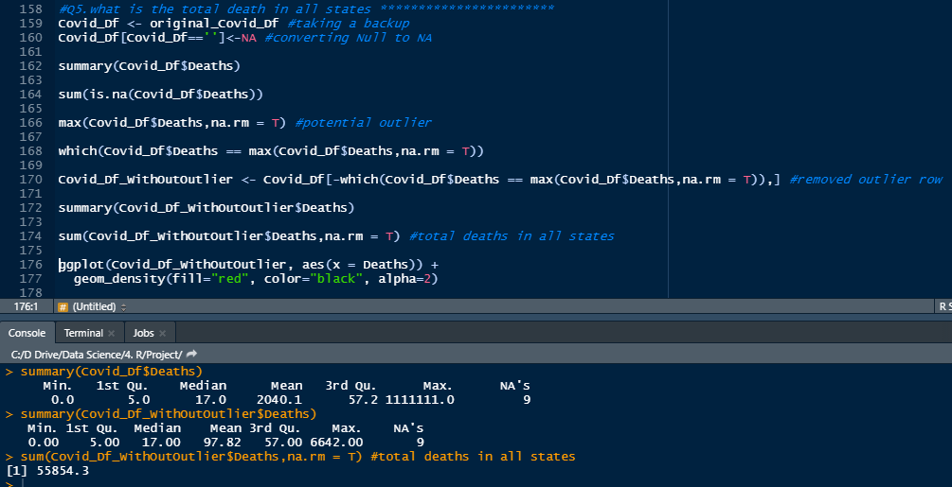
Q2. what is the total deaths in all states [Continuous]
The Central tendency can be used to get the details of the death column.
The outliers found from the initial analysis is removed.

Slide 8
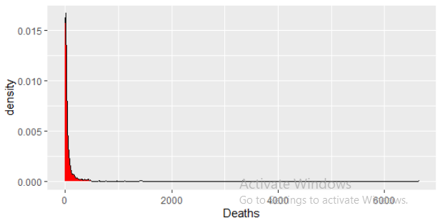
The visualization is done using a ggplot density plot after removing the outliers.

Slide 9
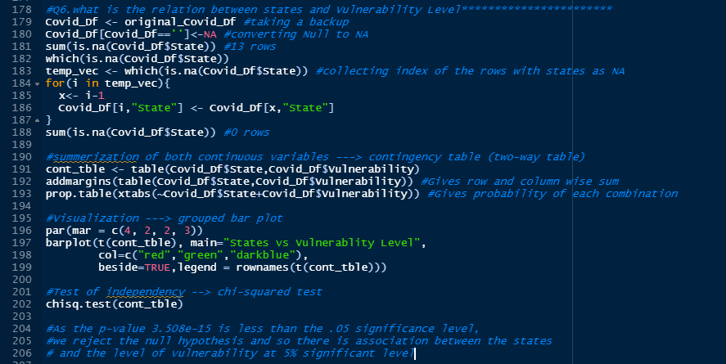
Bivariate Analysis
Q1. what is the relation between states and Vulnerability Level [Categorical vs Categorical]

Slide 10
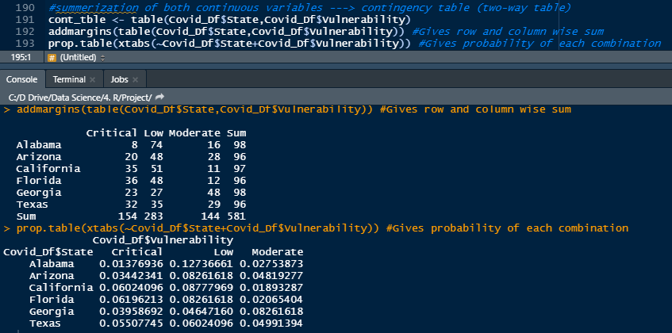
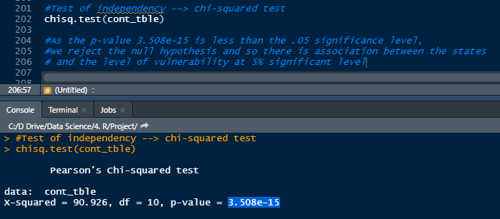
The summarization is done using 2 way table.
Table function or xtabs function can be used.
Further details could be fetched using the
Addmargins and prop.table which gives the sum of each column and probability of each combination respectively.
Test of independence is done using the chi-squared test
As the p-value 3.508e-15 is less than the .05 significance level, we reject the null hypothesis and so there is association between the states and the level of vulnerability at 5% significant level.

Slide 11
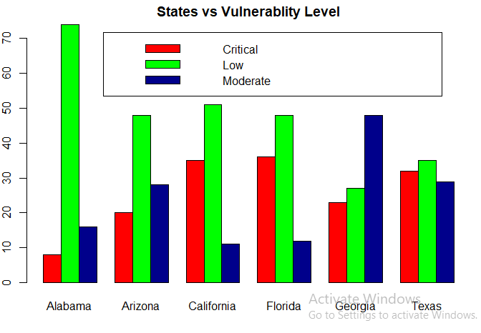
We use grouped bar chart for plotting categorical vs categorical variables as shown in the above picture

Slide 12
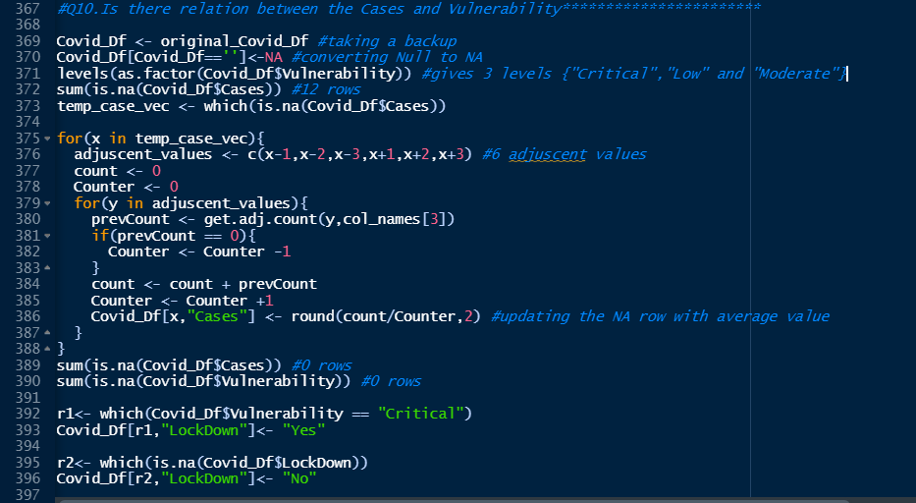
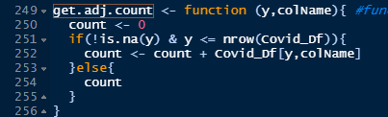
Q2. Is there relation between the Cases and Vulnerability [Continuous vs Categorical]

Slide 13
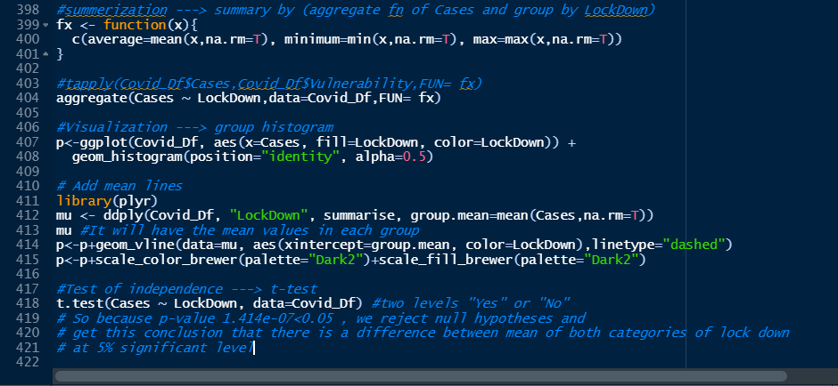

The summarization is done using aggregate function and it takes the aggregate of Cases and group by the Lockdown value.

Slide 14
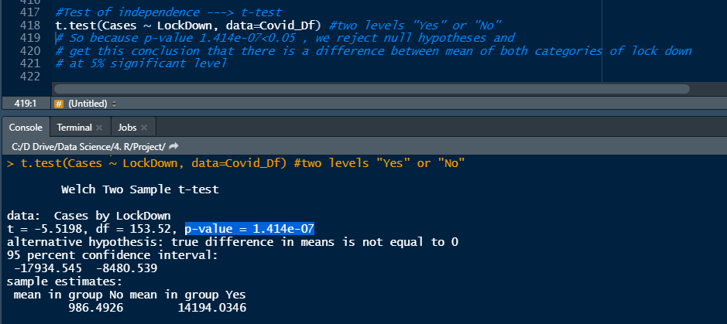
t-test is used for test of independence
So because p-value 1.414e-07<0.05 , we reject null hypotheses and get this conclusion that there is a difference between mean of both categories of lock down at 5% significant level

Slide 15
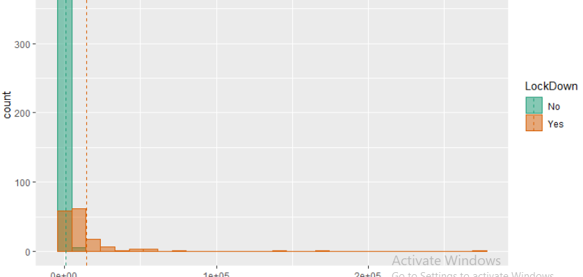
Visualization is done using grouped histogram and mean values of each group is drawn using vertical spaced lines.

Slide 16
CONCLUSION
The take away from this project are.
Nearly half of the vulnerability levels were Low
Critical vulnerability was slightly higher than the moderate vulnerability level
All 6 states were almost equally distributed over the period
There is strong association between states and vulnerability
There is strong association between cases and vulnerability
The months and vulnerability are not associated with each other and need more observations
There is high linear correlation between cases and recovery and death levels
Recommendation:
When critical vulnerability and number of cases are high, there should be lockdown

